Slide 1
Infant Nutrition and Breastfeeding in the Era of Precision Health
Dominick Lemas, PhD, CLC
Health Outcomes & Biomedical Informatics
University of Florida College of Medicine
FSU Nutrition, Food, and Exercise Seminar Series
October 16, 2019

Slide 2



















Burlington, VT
Seward, AK
Fairbanks, AK
Aurora,CO
Gainesville,FL
Birmingham,AL
F32
K01

Slide 3
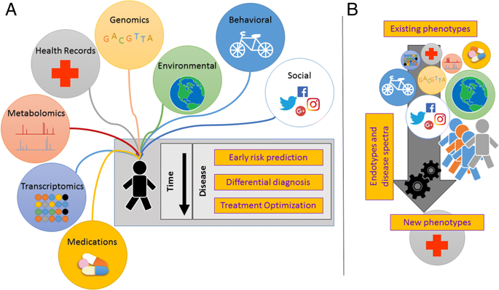
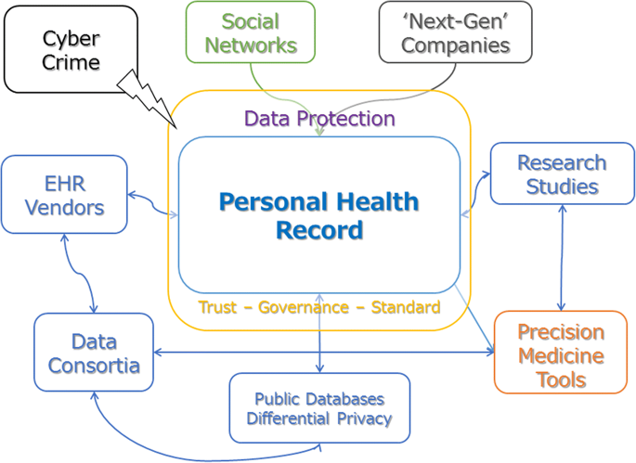
Precision HealthCare
Moving beyond genomics to include data that is not traditionally included in assessment of health/disease.
Electronic health records are becoming the central way to integrate all health information.
Prosperi et al. 2018. BMC Medical Informatics and Decision Making

Slide 4

The fetal origins of health & disease
In the United States
4.9 million infants are delivered annually.
50% of infants have mothers that were either overweight (25.6%) or had obesity (24.8%) before becoming pregnant.
Maternal obesity increases infant risk of:
Obesity & Cardiovascular disease
Breastfeeding
8-10 million women are pregnant or lactating.
Only 1 in 4 children are exclusive breastfeeding thru 6 months of life.
Breastfeeding reduces infant risk of :
Obesity & Cardiovascular disease
Independent of maternal BMI
October 6, 2010
How?

Slide 5
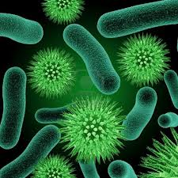

Research interests
Precision Public Health: How does breastfeeding impacts infant outcomes?
Natural language processing of clinical notes in mom-baby EHR
Geocoding using zip-code to determine the social determinants of health
Precision Medicine: What role does microbe-host interactions play in mediating the health benefits of breastfeeding?
N=100
Icons by Matt Daigle - Mothering.com

Slide 6
Pediatric obesity in florida
Among 2-19yrs (n=331,641) in Florida, 16.9% were obese.
Obesity prevalence among children >6 yrs (19%) was double the prevalence of obesity among children 2-5years (9.9%).
Rural Florida (21.7%) and non-Hispanic children with multiple races had the highest obesity prevalence (21.1%) across all racial/ethnic groups.
Electronic health records (EHRs) are low-cost method to track pediatric obesity.
Prevalence
OneFlorida Pediatric Obesity Prevalence by County. Obesity prevalence at the county-level in Florida children among children in the OneFlorida Data Trust between January 1, 2012 through December 31, 2016.
Lemas et al. Obes Res Clin Pract. 2019 Jan - Feb;13(1):12-15

Slide 7
Host-Microbe interactions
Microbiota
Microorganisms
-40 trillion cells
-3 million genes
Obesity Risk
Environment
Metabolites
Microbe-Host Interactions
Human
-37 trillion cells
-23 thousand genes
Adapted from Zhao. 2013. Nature Reviews Microbiology

Slide 8


Infant Microbiome and obesity
Maternal obesity
Altered Gut Microbiota
Mode of Delivery
Antibiotic exposure
Risk of Childhood Overweight
Breast milk
Gestation
Probiotics and/or Prebiotics
Adapted from Koleva et al. 2015. Nutrients

Slide 9
NIH/NIDDK K01 Overview
Over-Arching Goal
Characterize the critical microbe-host interactions that mediate the anti-obesity effects of breastfeeding.
Training
Clinical & Translational Research
Metabolomics
Biomedical Informatics
Specific Aims
Compare strategies for recruiting pregnant and breastfeeding mothers’ into longitudinal microbiome studies.
Characterize the role of the human milk metabolome in development of the infant microbiome.
Identify how the human milk metabolome is associated with infant adiposity.

Slide 10
Getting funded
Timeline
June 2016- IRB started
December 2016- IRB Approved
February 2017-First K01 Submission
May 2017- First Participant Enrolled
June 2017- NIH Impact Score 35
July 2017- kid #2
September 2017- hurricane Maria
February 2018- Second K01 Submission
July 2019- NIH Impact Score 30
January 2019- Funded
October 2019- ~50 participants
1st Submission Reviewer Comments
Over-ambitious
How do you recruit participants?
What about antibiotics?
What are the candidate metabolites?
2nd Submission Reviewer Comments
What about adding a germ-free models?
Maintain a good relationship with your program officer!

Slide 11





engagement
qualitative study
Lemas Lab Overview
clinical study
computing analysis
lab processing
Notes:
Population: This section of our workflow constitutes getting involved within the communities and informing potential participants of the study. Additionally, we involve ourselves within networking with the community and other organizations to try and expand our study. The final goal of our study is the dissemination of our collected information on pediatric obesity to the community.
Clinical: During our clinical section we begin by having a study visit of the mother where we ask them to answer some documents that provide us with valuable data. These visits are the same as pre and post natal health visits and provide the mother a time to review their health. We additionally collect Biological samples at certain times within the pregnancy and post pregnancy outlined by the longitudinal study section.
Lab: Within the lab we take collected samples and archive them within the lab and make sure that proper procedures are taken to avoid potential PHI (protected Heath information) leaks. We also preform test on collected samples and also outsource sample processing to other labs such as SECSUM. We also use certain Data bases to correctly archive and track the functions of the lab day to day.
Computation: During this section of the workflow we take processed data and analyze it. Before we can analyze the data we have the create a computational workflow that the data will be processed through. This allows us to create an efficient process through which the processed data can be passed through and provide us with significant information that we can then review foe analysis. We primarily do this through the hipergator, R programing, and other statistical and metabolomic based platforms.

Slide 12
Major projects in lab
16,000 linked pairs
Height/weight, ICD9/10
Medications/Insurance
Mom-baby EHR Study
100 linked pairs
4 clinic visits
Biological samples
Questionnaires
Clinical Study
Questions
Sample Size
40 mother
Semi-structured interview
Biological samples
Questionnaires
Interview Study

Slide 13
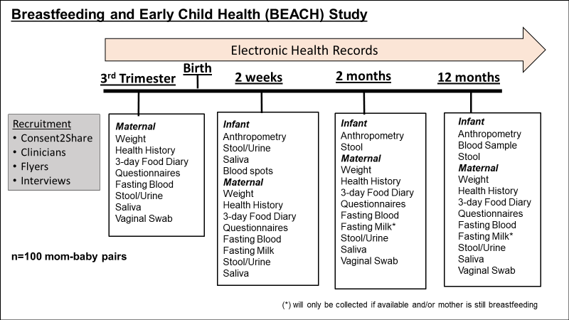
 | NW (BMI<25) | Ob (BMI>30)
VG (Vaginal) | 25/25 | 10/25
CS (C-section) | 7/25 | 4/25

Slide 14
Data Ecosystem
CTSI
-billing
-scheduling
-participant data
-sample processing
-EHR
UF Sequencing
-billing
-sample processing
-data
My Lab
-RedCap
-Freezerworks
-Hypergator
IRB
-reporting
-protocols
-ICF
-participant compensation
UF Metabolomics
-billing
-sample processing
-data
Public Space
-participants
-publications
-data repository

Slide 15
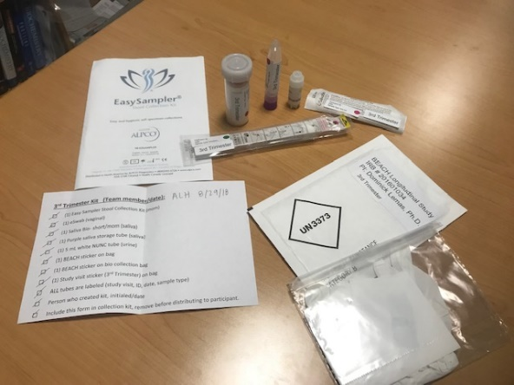
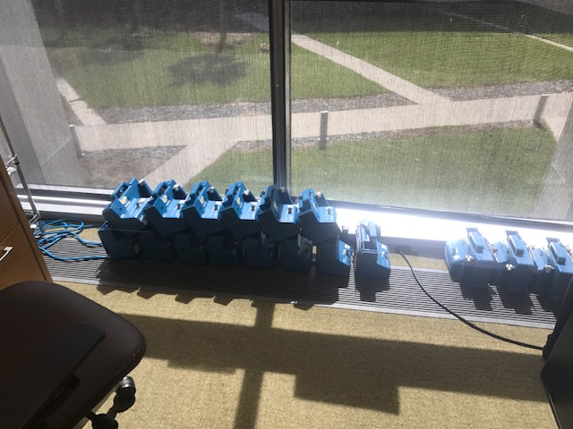
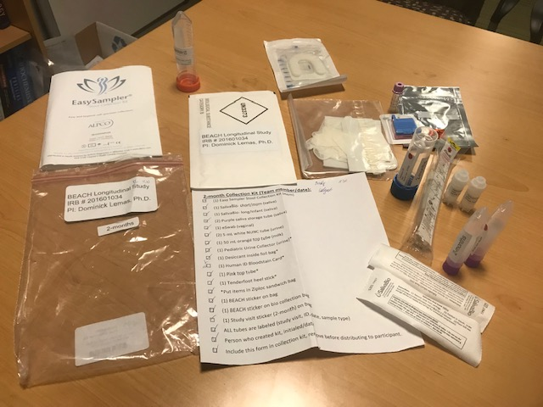
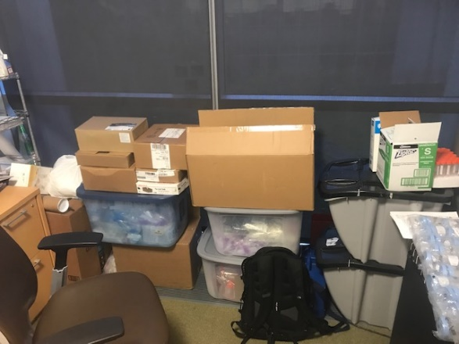
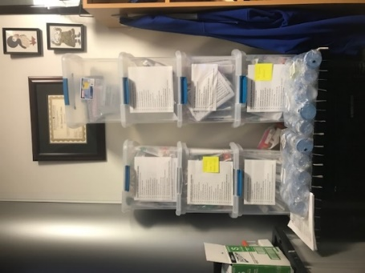
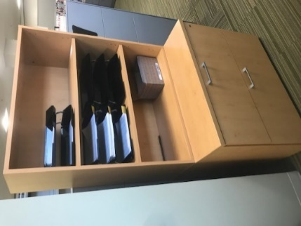
Biological Sample collection
Prenatal Collection
Hospital Grade Breast Pumps
Postnatal Collection Kits
Organization of Bulk Materials
Organization of Collection Kits
Organization of Data Collection

Slide 16
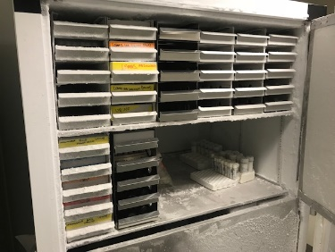
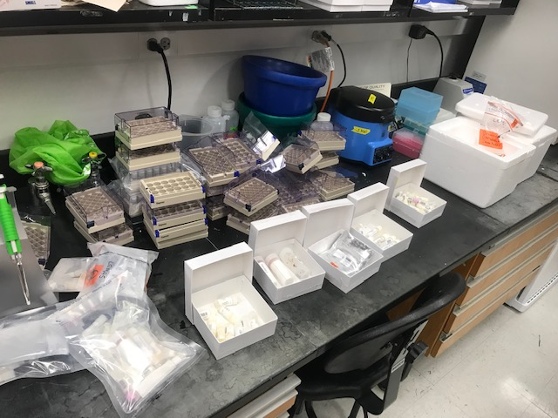
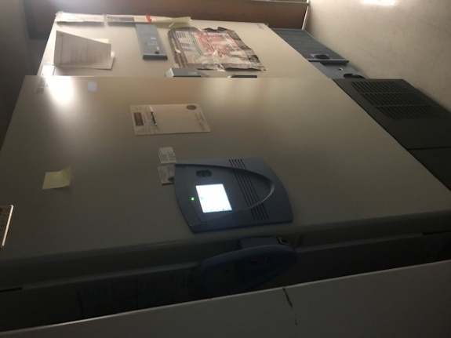
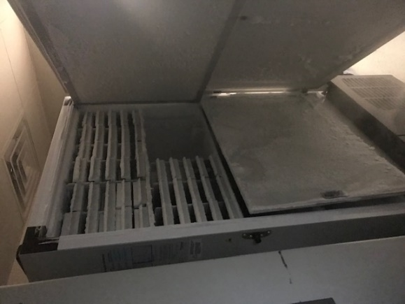
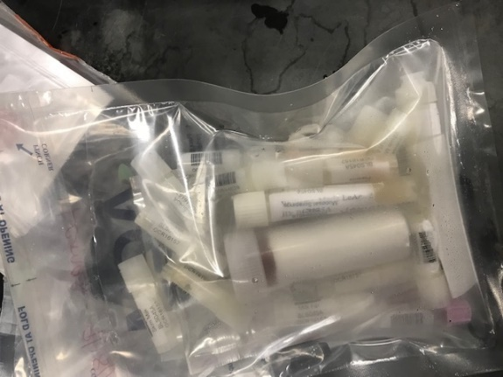
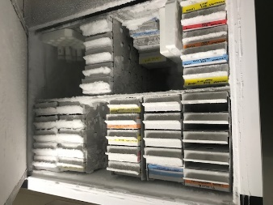
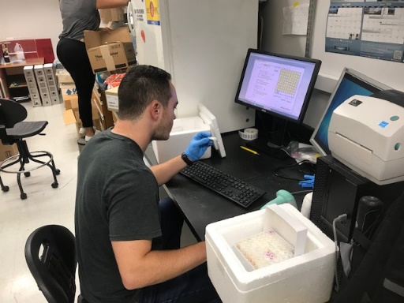
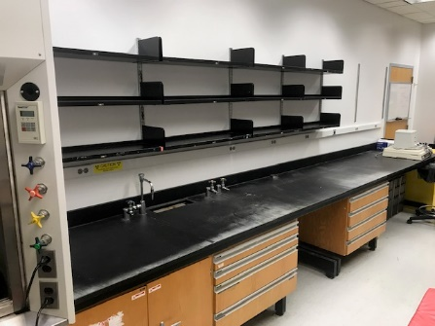
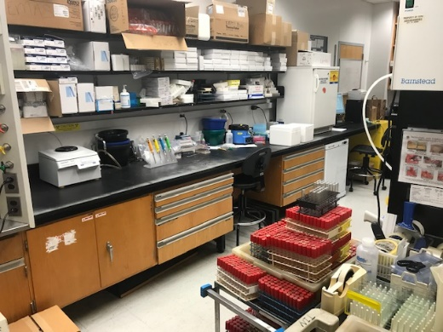
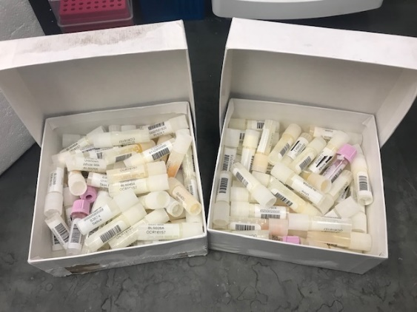
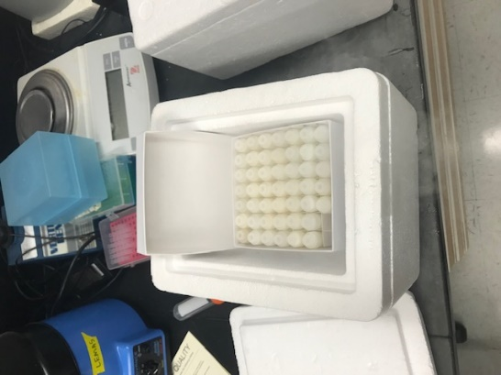
Biological Sample Archiving

Slide 17
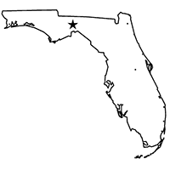
Reviewer #2: How do you recruit participants?
Aim 1. Characterize maternal perspectives related to participation in longitudinal microbiome studies using informative interview.
Aim 2. Test the efficacy of recruitment strategies in a diverse sample of Florida mothers using online surveys.
15 min survey on participant recruitment and retention
Data-driven participant recruitment plan
N=100

Slide 18





INTERVIEW STUDY OVERVIEW
Phone Screen
Schedule Interview
Collection Kit
Informative Interview
Data Analysis
Study Groups
Women in 3rd trimester of pregnancy committed to breastfeeding (n=20).
Women breastfeeding their infant during first 12-months of life (n=20).
Data Collection
Self-report surveys related to maternal-infant health and infant feeding.
Non-invasive biological samples (i.e. stool, urine, human milk, saliva).
~1 hour semi-structured interview.
Sample Interview Questions
How familiar are you with research?
How long should a study visit last?
What are challenges to recruiting pregnant women for longitudinal studies?
Are there biological samples you would NOT want collected on you? Your infant?
Biological Sample Collection kit
1
2
3
4

Slide 19

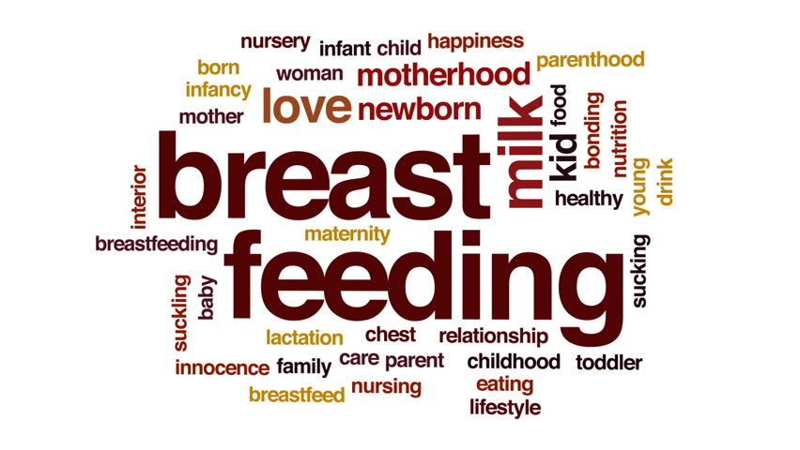
DATA PROCESSING AND QUALITATIVE ANALYSIS
1
2
3
4
Audio recordings were transcribed verbatim into text documents.
Using Nvivo, text documents were “chunked” into categories:
Prior exposure to clinical research
Perspective on clinical research participation
Biological samples & sample kit
Qualitative analysis identified themes within categories.
Sub-group analysis and data visualizations.
Example Visualization

Slide 20
STUDY RECRUITMENT & DEMOGRAPHICS
Variable | Pregnant | Breastfeeding | p-value
n | 20 | 20 | --
Age | 31.4 (4.9) | 30.5 (4.5) | 0.54
Pre-pregnant BMI (kg/m²) | 26.8 (7.5) | 24.2 (5.5) | 0.22
Interview Length (min) | 46.0 (10.6) | 47.2 (14.3) | 0.77
Outcomes
103 Encounters
76 Phone Screens
47 Consented
40 Interviewed
39 1+ sample
23 ALL samples

Slide 21
Participation IN RESEARCH
Motivations:
Interest in breastfeeding
“Honestly . . I would say just the fact that it was about breastfeeding mothers. I struggled with breastfeeding … I know how valuable it is …. I'm interested in breastfeeding and I want there to be research about it (BIS014)”.
Barriers:
Convenience
“Time is definitely the biggest barrier just because I had this super-long to-do list of all these things I wanted to get done before I had the baby (BIS001)”.
“Ideally, someone would be there to come pick it up from my house, or I could stick it in the mail because there is no way I can poop on demand (BIS001)”.
Biological Samples:
Adequate Instructions
Drop-off Convenience
“the sample collection [needs to be] streamlined and lrequire as little amount of time …. because I’m dealing with … work and screaming kids (BIS006)”.

Slide 22
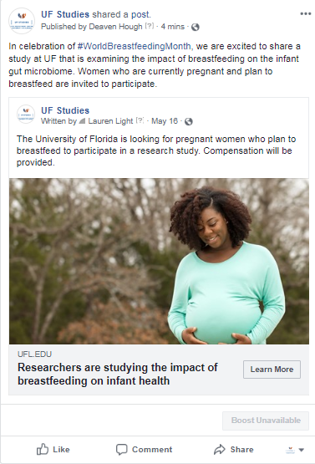
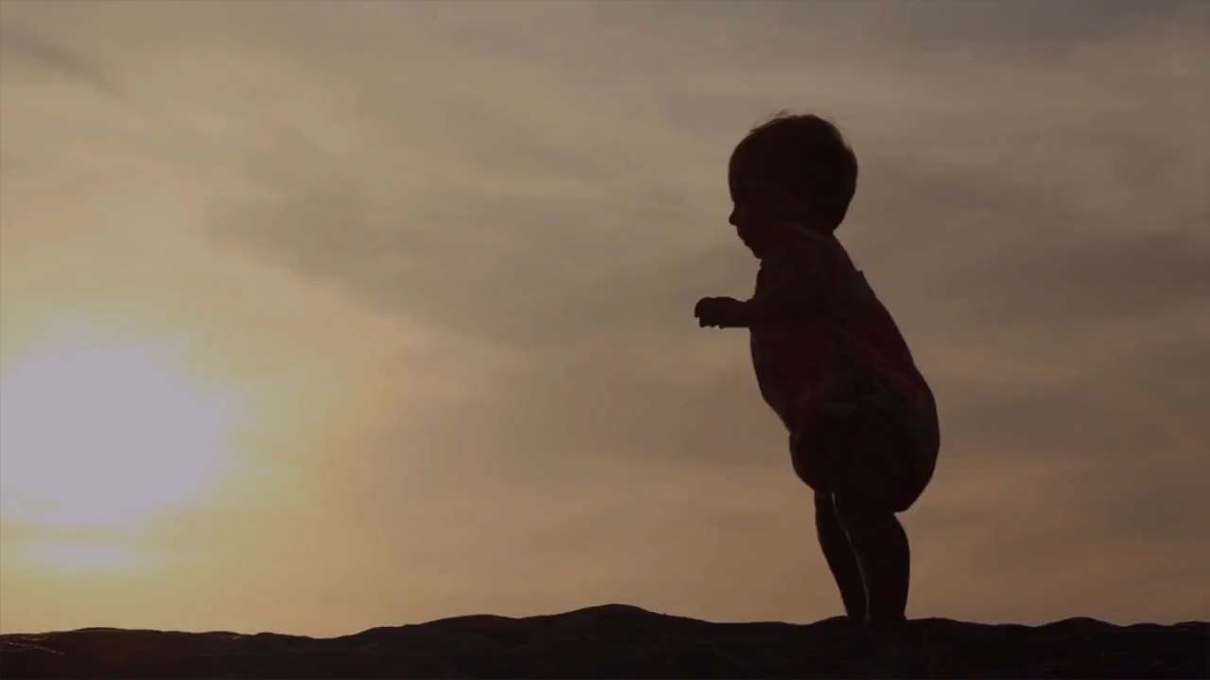
PARTICIPANT Recruitment using social Media
“I think getting the word out through… social media, there's lots of moms groups and even people are in groups when they're pregnant and expecting. I know on Facebook I'm part of a couple of breastfeeding groups (BIS019).”

Slide 23
Recruitment using social Media
Total Encounters (n=467)
BEACH Longitudinal (n=398) |  | BEACH Interview (n=69)
Email | Phone | Email | Phone
342 (85.9%) | 54 (13.5%) | 52 (75.4%) | 16 (23.1%)
As of March 2019
BEACH Interview Phone Screenings (n=78)
Flyer (n=31, 39.7%) |  | Social Media (n=24, 30.7%)
Pass (n=27) | Fail (n=3) | Pass (n=23) | Fail (n=1)
BEACH Longitudinal Phone Screenings (n=219)
Flyer (n=91, 41.4%) |  | Social Media (n=102, 46.5%) |  | Word-of-Mouth (n=26, 11.8%)
Pass (n=56) | Fail (n=28) | Pass (n=30) | Fail (n=14) | Pass (n=4) | Fail (n=2)

Slide 24
Reviewer #2: WHAT ABOUT ANTIBIOTICS?
Common pediatric diagnoses that requires antibiotic prescription:
asthma
respiratory distress
gastrointestinal infections
Are the same infant health outcomes linked to c-section delivery.
We hypothesized that infants delivered via cesarean section will be more likely to be prescribed antibiotics than vaginally delivered infants.

Slide 25
UFHealth EHR infant population by mode of delivery, 2011-2017
 | Total n = 4,024 | Cesarean Section n = 1,211 | Vaginal Delivery n = 2,813 | p-value
Infant Characteristics
Gender
Female | 49.3 | 47.8 | 49.9 | 0.2297
Male | 50.7 | 52.2 | 50.1
Race/Ethnicity
Non-Hispanic White | 41.3 | 42.1 | 40.9 | 0.3139
Non-Hispanic Black | 33.4 | 34.5 | 32.9
Non-Hispanic Other | 16.9 | 15.6 | 17.5
Hispanic | 8.4 | 7.8 | 8.7
Gestational Age (weeks), M (SD) | 39.4 (1.1) | 39.3 (1.1) | 39.5 (1.1) | <.0001
Baby Birth Weight (grams) , M (SD) | 3333.1 (426.9) | 3374.7 (460.4) | 3315.2 (410.5) | 0.0001
Analysis Cohort (n=3,360)
first-born singleton
term infants (37- 42 weeks gestation)
birth weight ≥ 2500 grams
excluded infants admitted to NICU

Slide 26
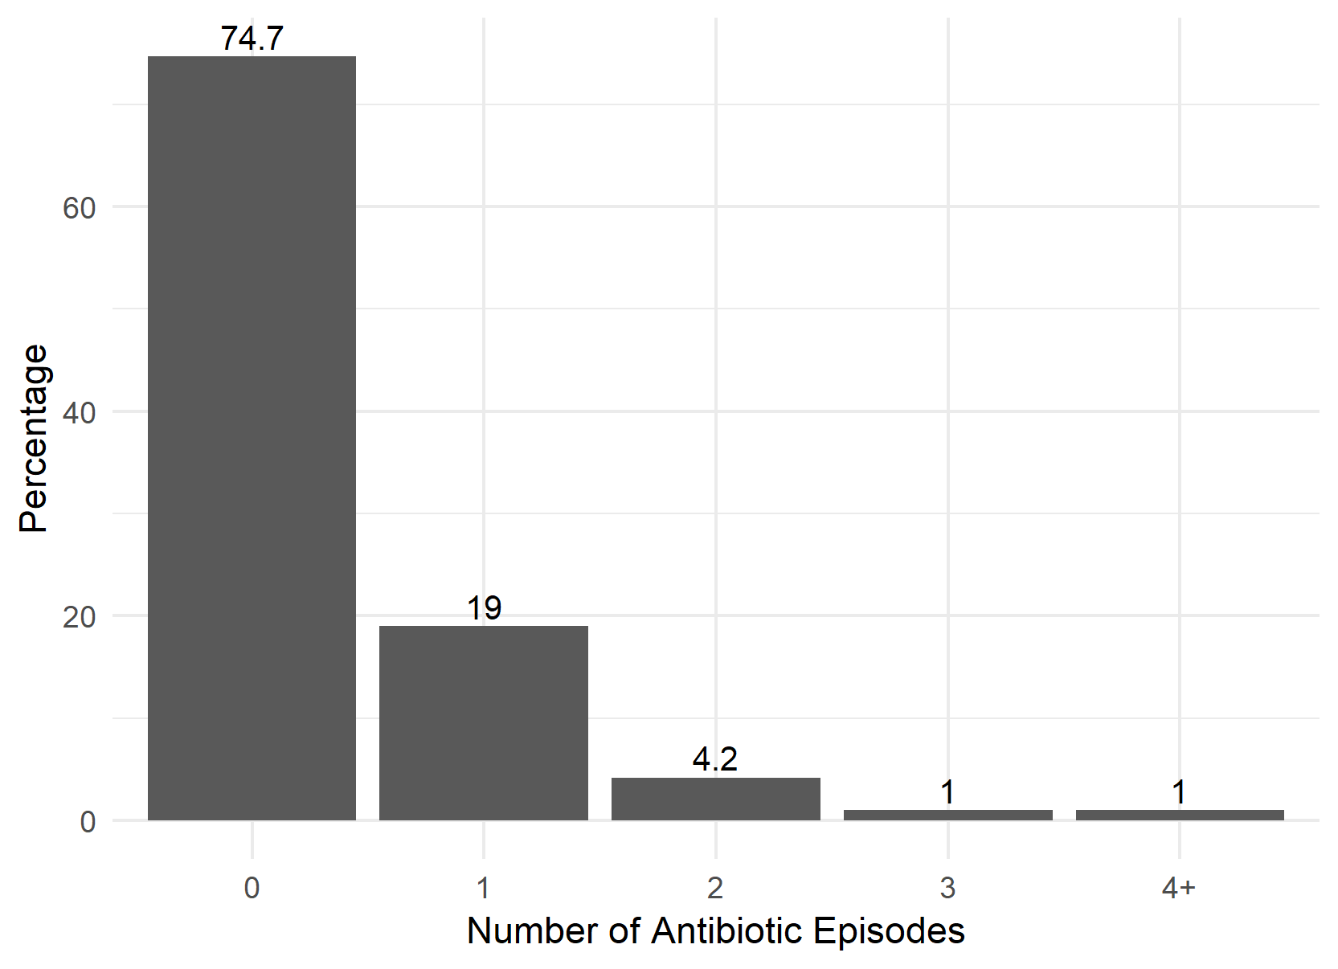
Pediatric antibiotics over first 3 years of life
Results
3/4 of children did not receive any antibiotics 0-3 years of life.
1 in 5 children received only a single course of antibiotics.

Slide 27
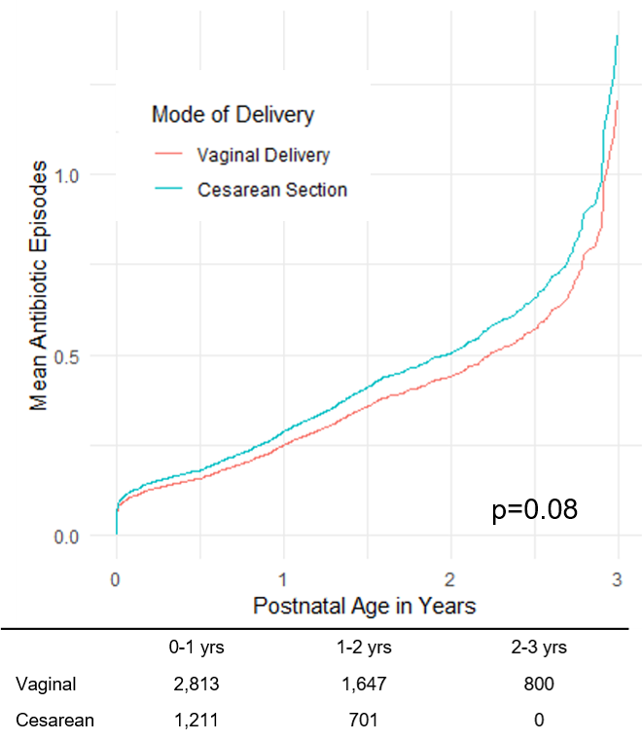
pediatric antibiotics by Mode of delivery
After adjusting for covariates, there was no statistically significant difference between the number of
total antibiotics (p = 0.08)
narrow-spectrum (p = 0.10)
broad-spectrum episodes (p = 0.17).
Currently, working to include maternal perinatal antibiotic episodes in analysis.

Slide 28
WHAT ARE THE CANDIDATE HUMAN MILK METABOLITES?
HiPerGator/UMPIRE
SECIM
Personal Workstation
Data Processing
Human Milk Sample (~1 ounce)
Statistical Analysis
blank subtraction
ANOVA
Kruskal Wallis
Repeated measures
Machine learning
xcms
mzMine2
Whole
Lipid
Skim
Metabolite Annotation
Match with SECIM Library
High-Resolution
Mass Spec
Match with Publicly Available Databases (KEGG, METLIN, HMDB)
Metabolite Validation
top 10-15 hits
Primary cell culture
Animal models
Secondary Analysis
Analysis Ready Data
Report on Data Processing
Raw Data
mzXML

Slide 29
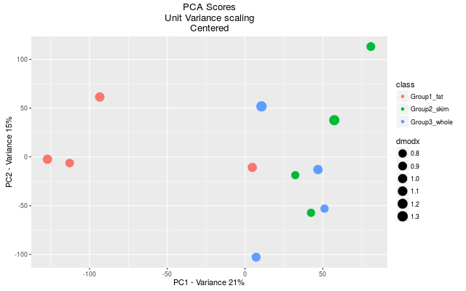
Preliminary metabolomics Results
Across All Fractions
Whole and skim fractions appear to cluster by PCA.
~9500 hits before QC.
~600 hits after QC.
~80 match to SECIM library
Statistically Different by Fraction
~100 hits differ by milk fractions.
44 hits w/ 1+ match to public database.
24 hits with ONLY 1 match to public database.
13 match to SECIM library
# of Matches
Lipid
Whole & Skim
# of Matches
10

Slide 30
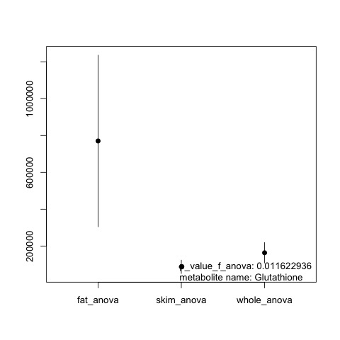
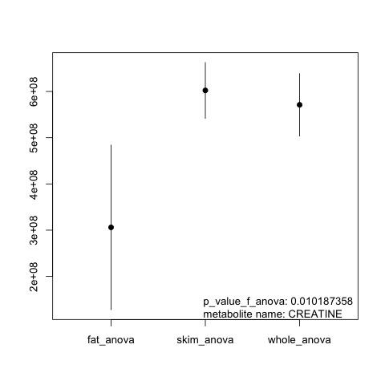
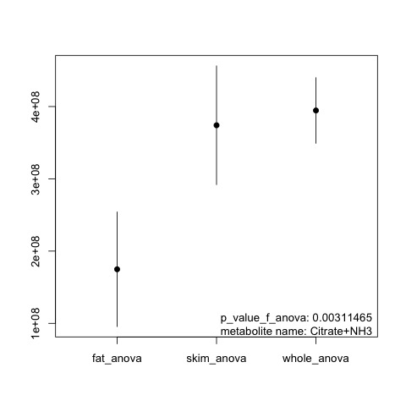
SECIM library metabolomics Results
Glutathione
Normal component of human milk
Antioxidant
Animal evidence gut microbiota regulates host glutathione metabolism.
Creatine
Normal component of human milk
Neural development
Human data linking creatine to changes in Proteobacteria
Citrate
Normal component of human milk, early lactation.
Evidence gut microbiota regulates host citrate metabolism.
p=0.011
Lipid Skim Whole
Glutathione is enriched in the lipid fraction human milk.
Creatine and Citrate and enriched in the skim and whole milk fractions.
p=0.010
Lipid Skim Whole
p=0.003
Lipid Skim Whole

Slide 31
Summary
Electronic health records are a low-cost data source to investigate how early exposures contribute to pediatric obesity.
Social media has been an effective tool to recruit pregnant and breastfeeding mothers.
Pediatric antibiotics do not differ according to mode of delivery in cohort of 4,000 UFHealth infants.
Human milk metabolites may contribute to changes in gut microbiome and health outcomes.

Slide 32
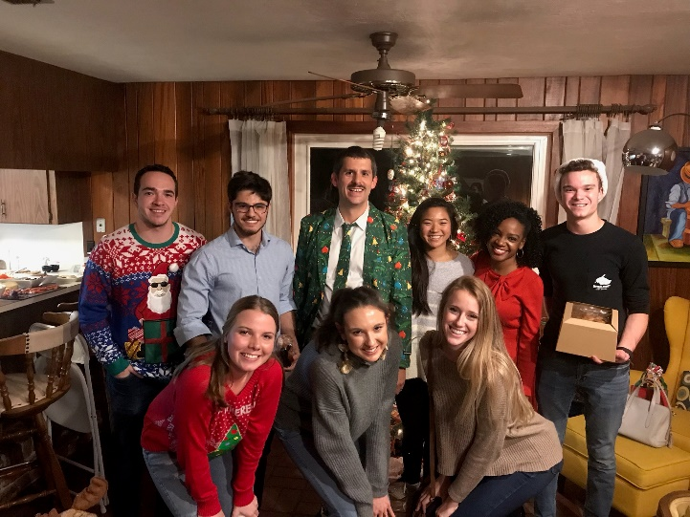

Acknowledgments
University of Florida
Christian Jobin, PhD
Raad Gharaibeh, PhD
Joe Neu, MD
Leslie Parker, PhD
Michelle Cardel, PhD
Bill Hogan, MD
Tim Garrett, PhD
Nicole Cacho, DO
Lindsay Thompson, MD
Dikea Roussos-Ross, MD
Janice Krieger, PhD
Keith Muller, PhD
Alice Rhoton-Vlasak, MD
Elizabeth Plasencia, MD
Mehmet Genc, MD/PhD
Magda Francois
Clinical Research Coordinator III
Lemas Research Group
Funding Source
K01 DK115632 (NIDDK); SECIM P&F; CTSI Pilot Award; Robin Hood Foundation; NIH Loan Repayment Program

Slide 33

Thank you!
Email: djlemas@ufl.edu Twitter: @dominicklemas

Slide 34
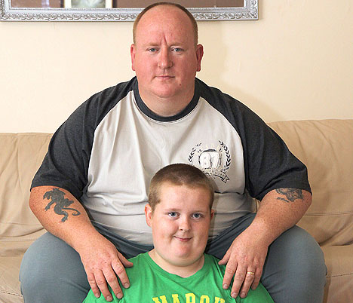
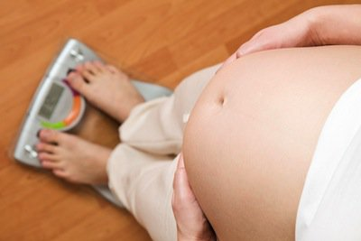

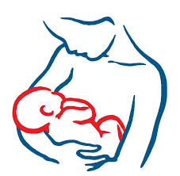
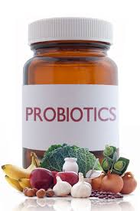
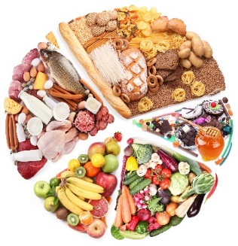

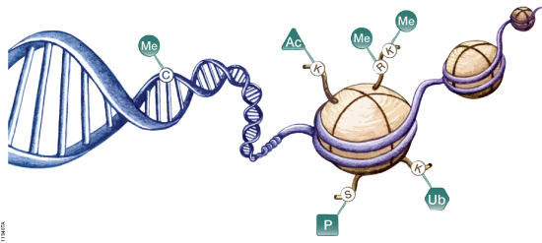
Open Questions
TTLE
Gestation
Genes
Antibiotics
Breastfeeding
Epigenetics
Mode of delivery
Informatics
Diet

Slide 35
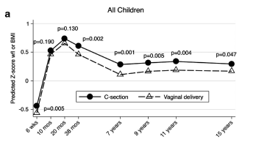
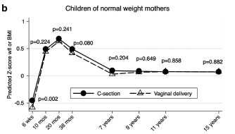
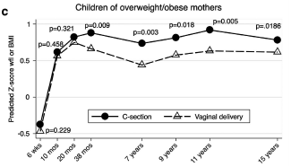
Cesarean delivery is associated with offspring obesity
TTLE
n=10,219
Maternal obesity modified association between C-section and offspring obesity.
Blustein et al. 2013. International Journal of Obesity

Slide 36
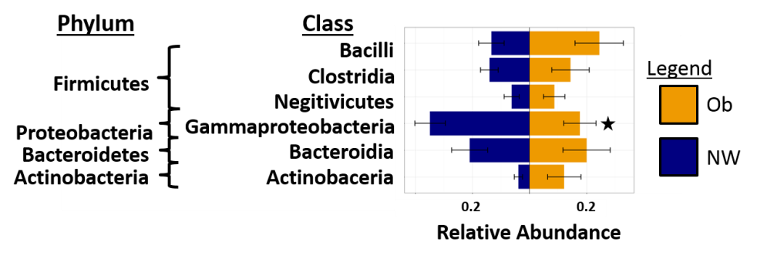
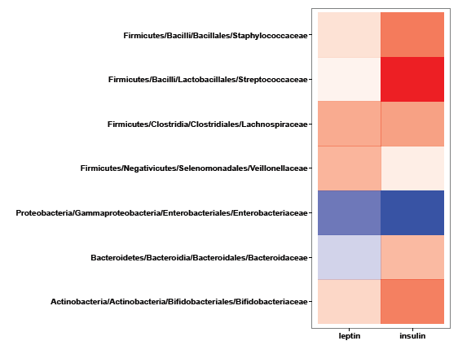
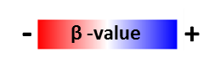
Preliminary Data
Phylum
Family
Staphlococcacea
Firmicutes
Streptococcaceae
Lachnospiraceae
Proteobacteria
Veillonellaceae
Enterobacteriaceae
Bacteroidetes
Bacteroidaceae
Actinobacteria
Bifidobacteriaceae
Leptin
Insulin
Figure 1
Figure 1. Taxonomic composition of the vaginally delivered infant gut microbiome at 2-wks according to maternal obesity (n=30).
Maternal obesity is associated with reduced levels of Proteobacteria/Gammaproteobacteria (p=0.03).
Figure 2. Influence of human milk hormones on the composition of the infant microbiome at 2-wks, independent of maternal obesity (n=30).
Milk insulin is positively associated with levels of Proteobacteria/Enterobacteriaceae (p=0.04).

Slide 37
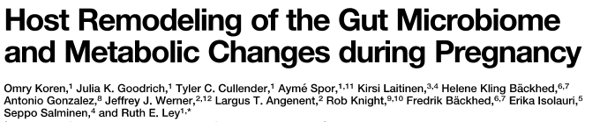
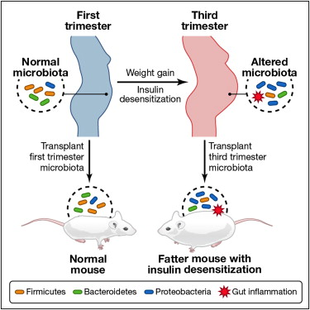
Phenotypes consistent with the physiological adaptation to pregnancy were transmitted to germ-free mice via the gut microbiome.
Koren et al. 2012. Cell

Slide 38
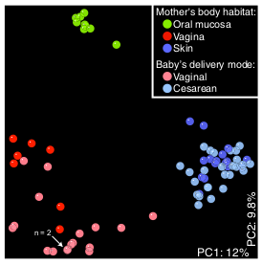
Infant microbiome differs according to mode of delivery
TTLE
Vaginally Delivered
Infants
Caesarian Delivered
Infants
Dominguez-Bellow. 2010. PNAS

